Slide 1
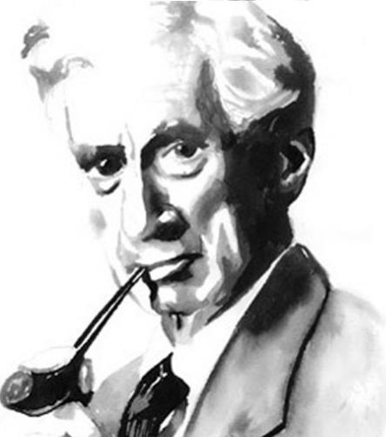
The World According to Bertrand Russell
- Practicing a Bird’s Eye-view or Generalist’s Approach to Making Meaning -

Slide 2
“The trouble with the world is that the stupid are cocksure and the intelligent are full of doubt.”

Slide 3
“In all affairs it's a healthy thing now and then to hang a question mark on the things you have long taken for granted.”

Slide 4
“I remain convinced that obstinate addiction to ordinary language in our private thoughts is one of the main obstacles to progress in philosophy.”

